Slide 1
Analysis of Anime Popularity
By: Jason Larosiliere

Slide 2
Agenda
Project Overview
Literature Review
Data Clean-Up
Exploratory Analysis
Predictive Modeling
Key Observations
Conclusion

Slide 3
Project Overview
Goal: Analyze the factors behind popularity of animes using data from MyAnimeList
Using Machine learning and Predictive analysis
Learning Project: Enhance my skills in SAS Enterprise throughout the analysis and modeling

Slide 4
Literature Review
Survey conducted in Malaysia to see how perception and attitude towards anime affect society’s behavior
Includes initial attitude towards anime, acceptance of anime and post acceptance behavior
Target audience for anime culture in America is racially diverse between ages 18-25
American Anime fans believe that Japanese culture is superior to culture here
Adults enjoy anime because they are cartoons with more complex storylines
“Realistic”
Find characters relatable
Rise of Manga Cosplay

Slide 5
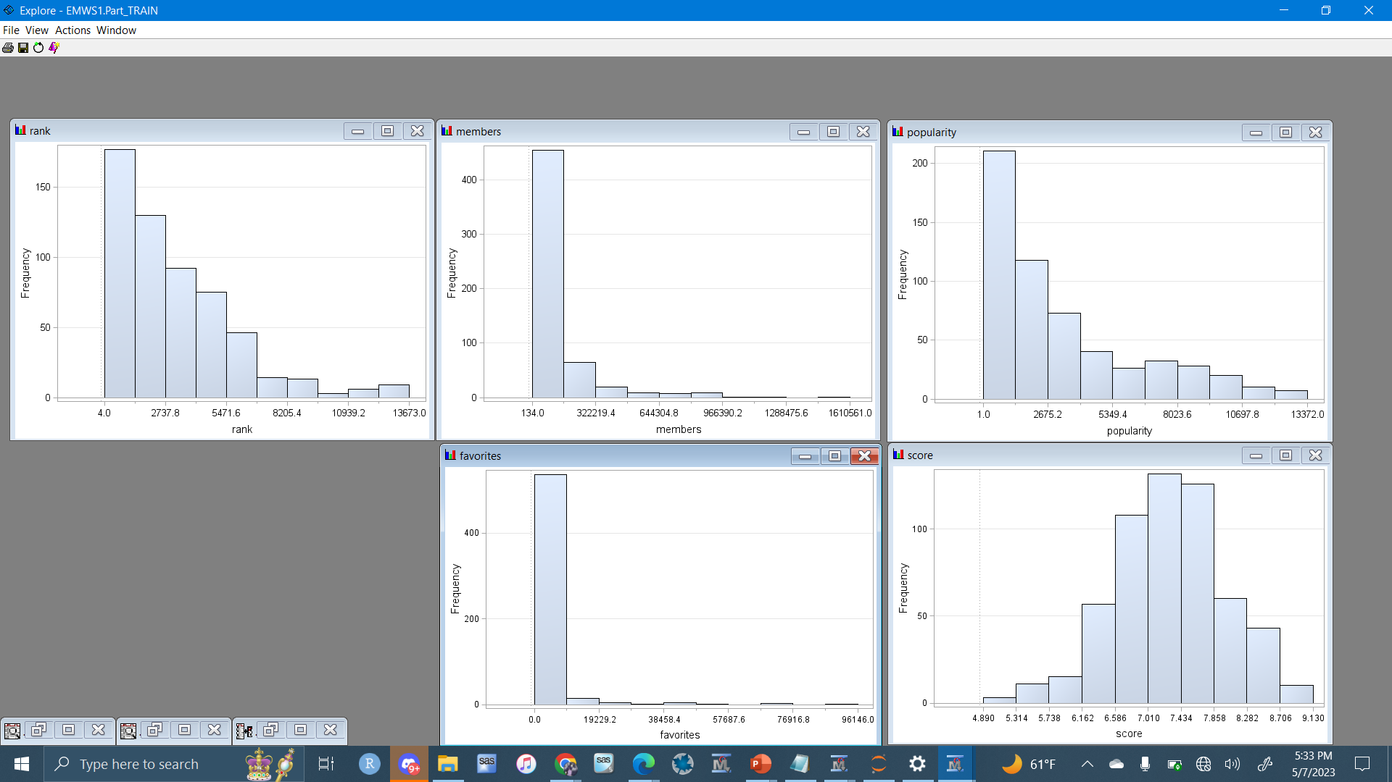
Data Clean-Up
Before Transformations

Slide 6
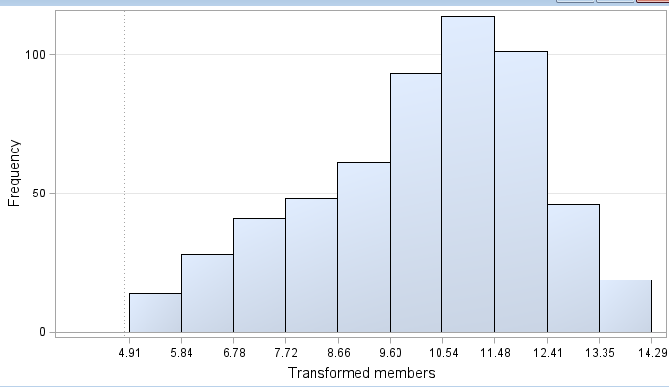
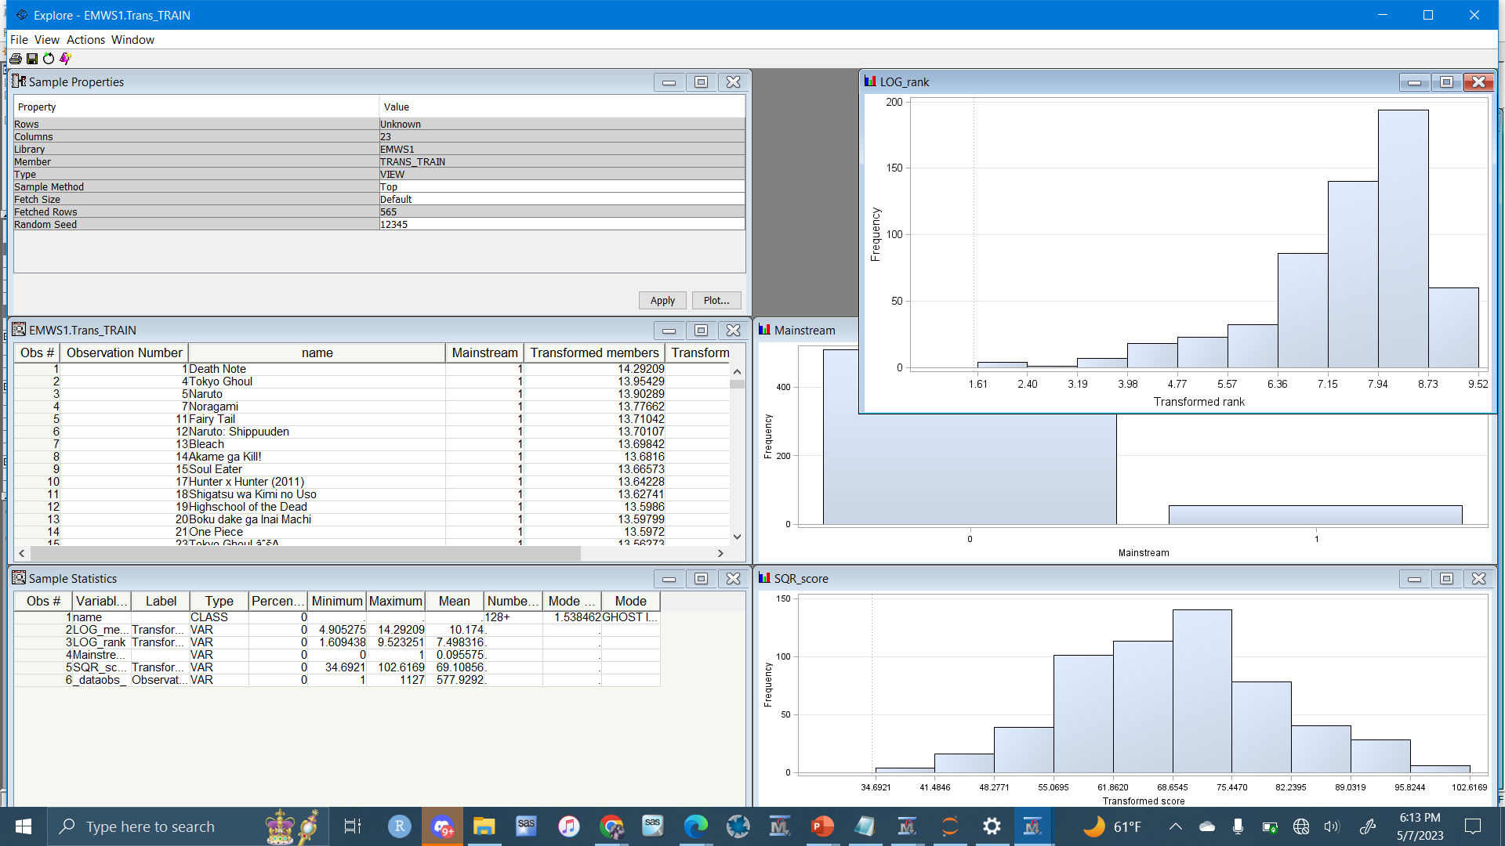
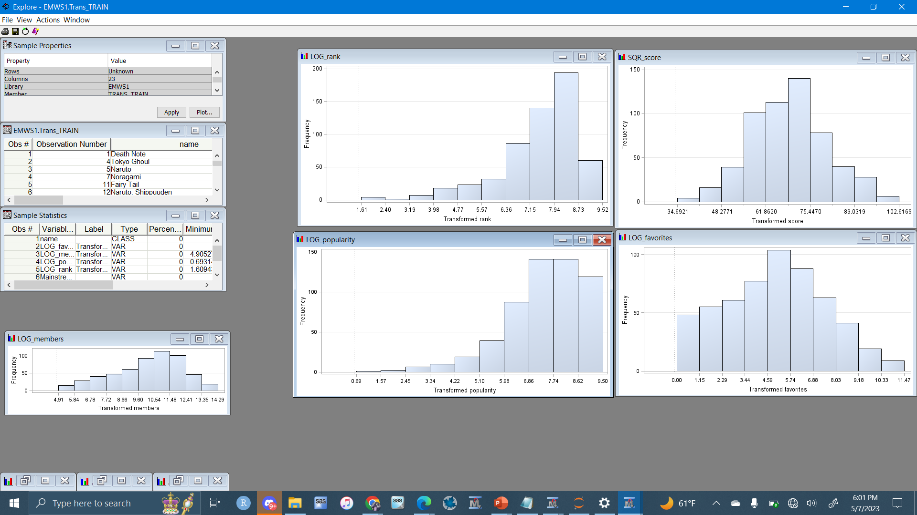
Data Clean-Up
After Transformations
1129 Observations
Variables:
Name
Genre
Producers
Rating
Episodes
Studio
Score
Rank
Favorites
Members(Target)

Slide 7
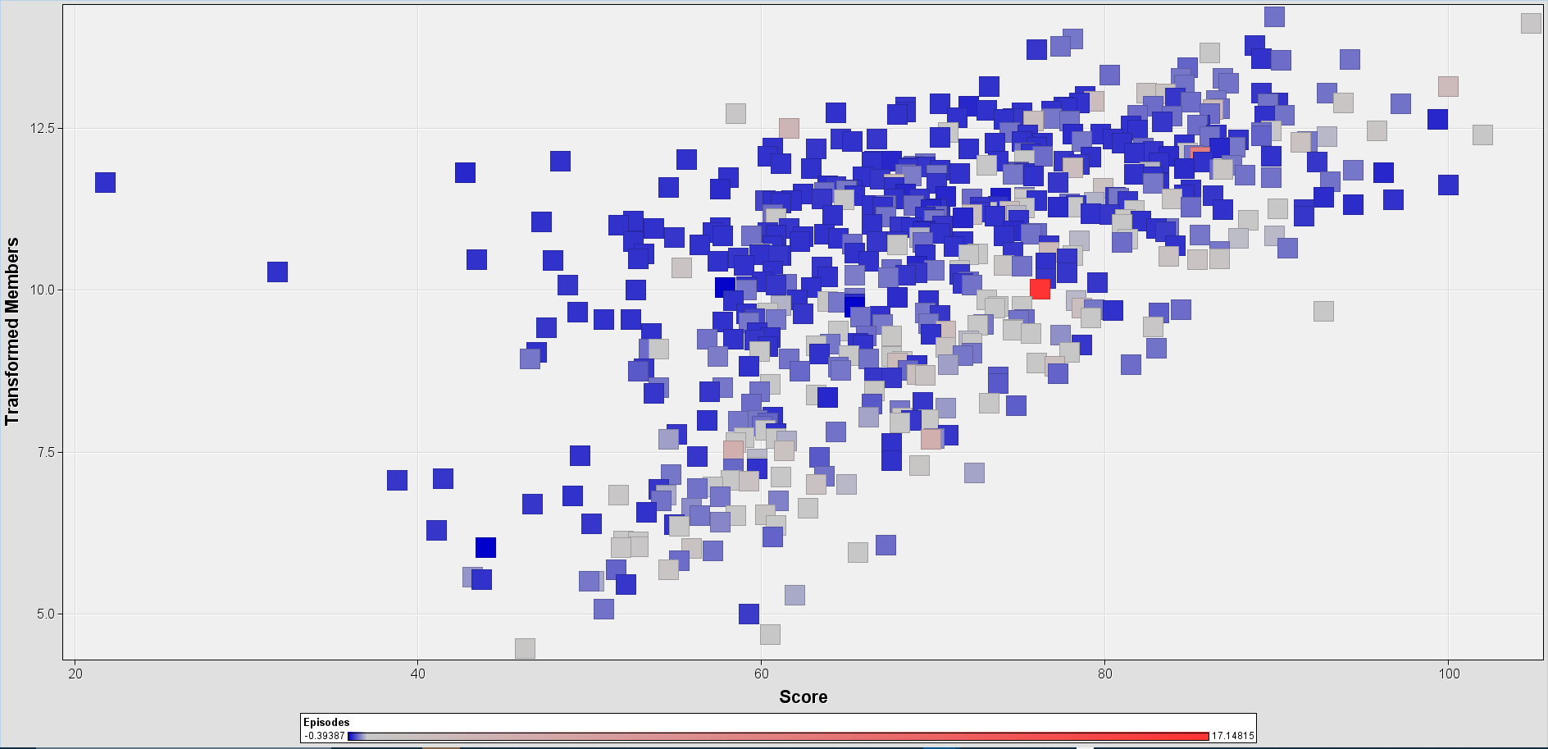
Exploratory Analysis
(IMDB) Score vs Members

Slide 8
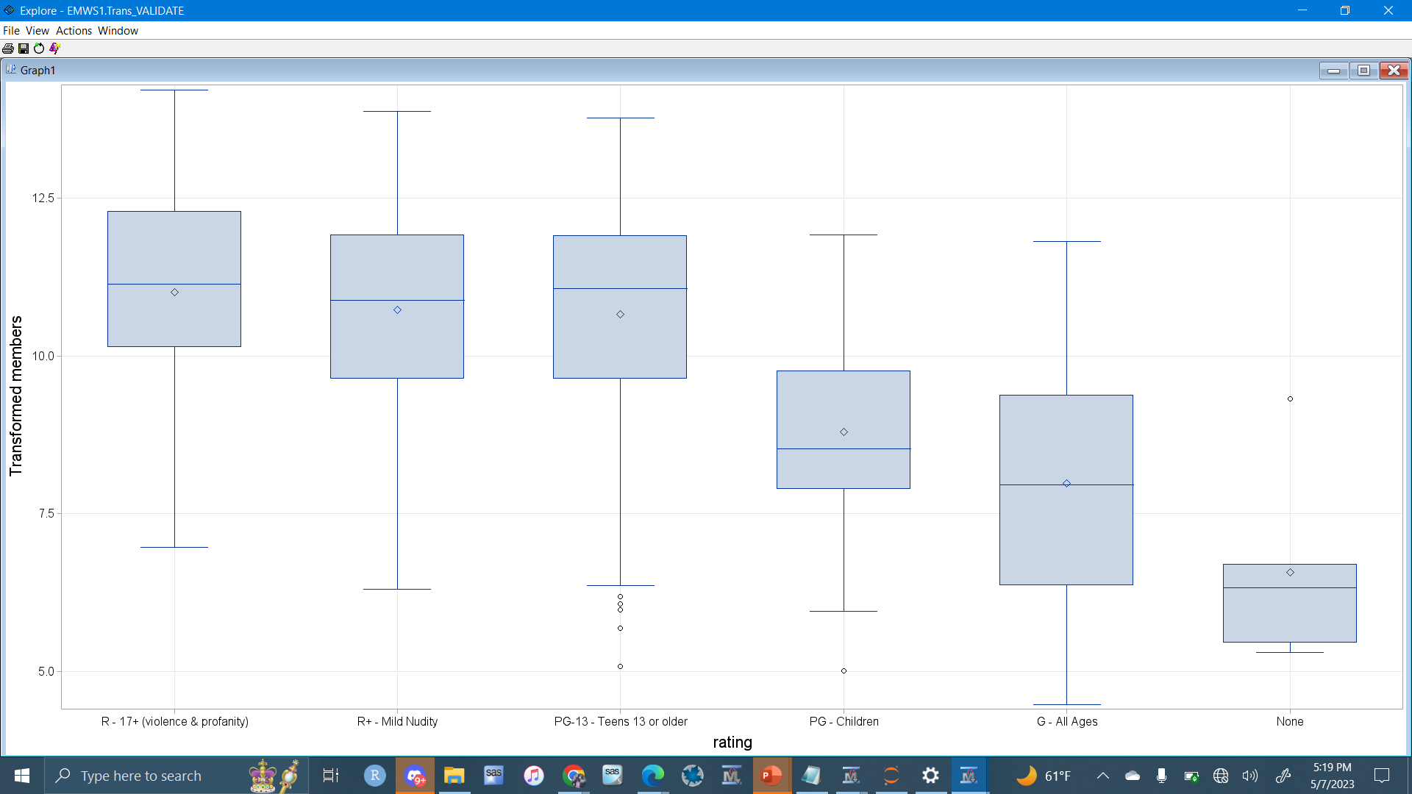
Exploratory Analysis
Rating vs Members

Slide 9
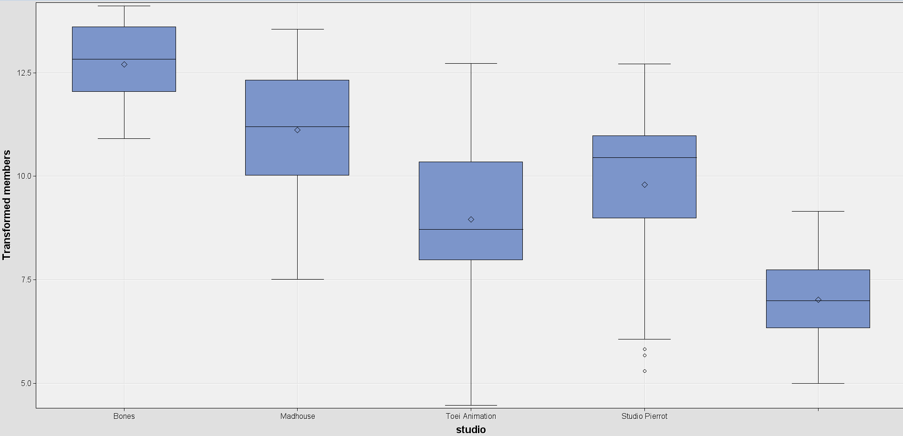
Exploratory Analysis
Production Studio vs Members

Slide 10
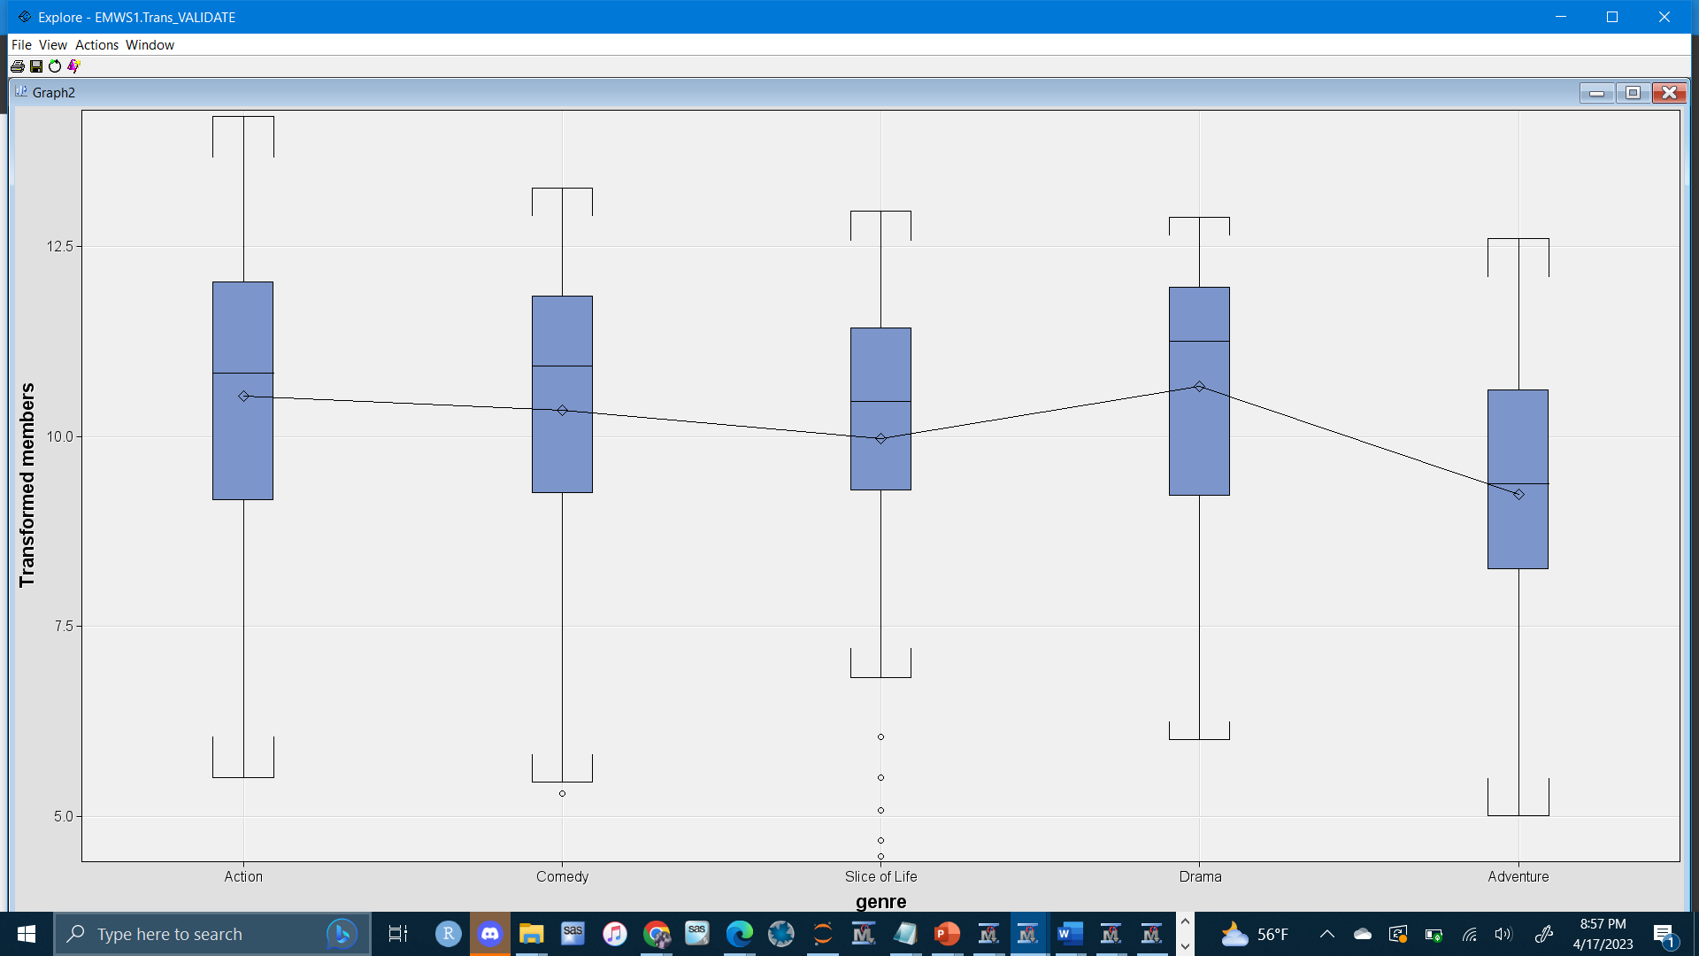
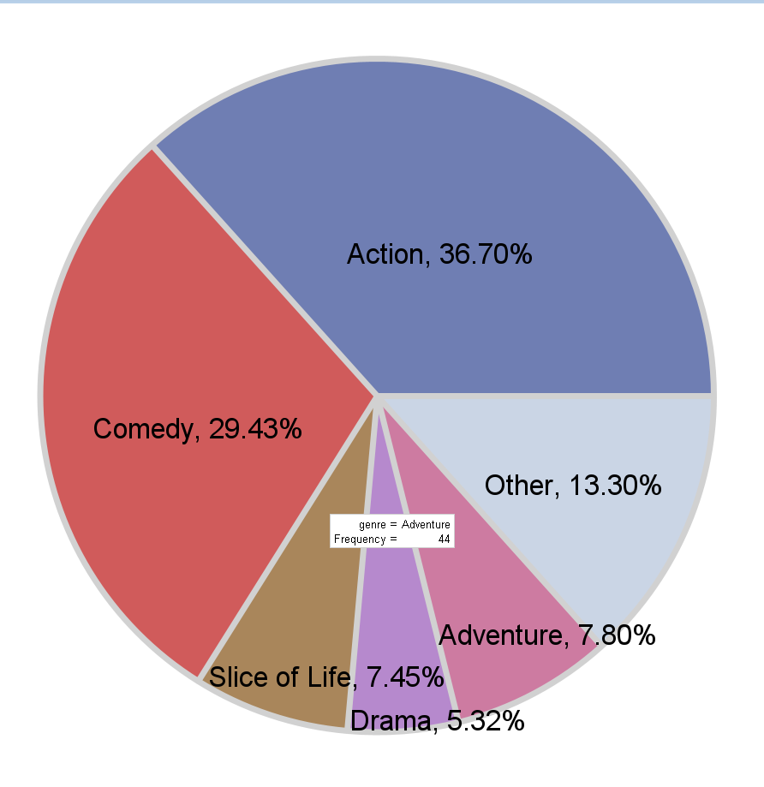
Exploratory Analysis
Genre vs Members

Slide 11
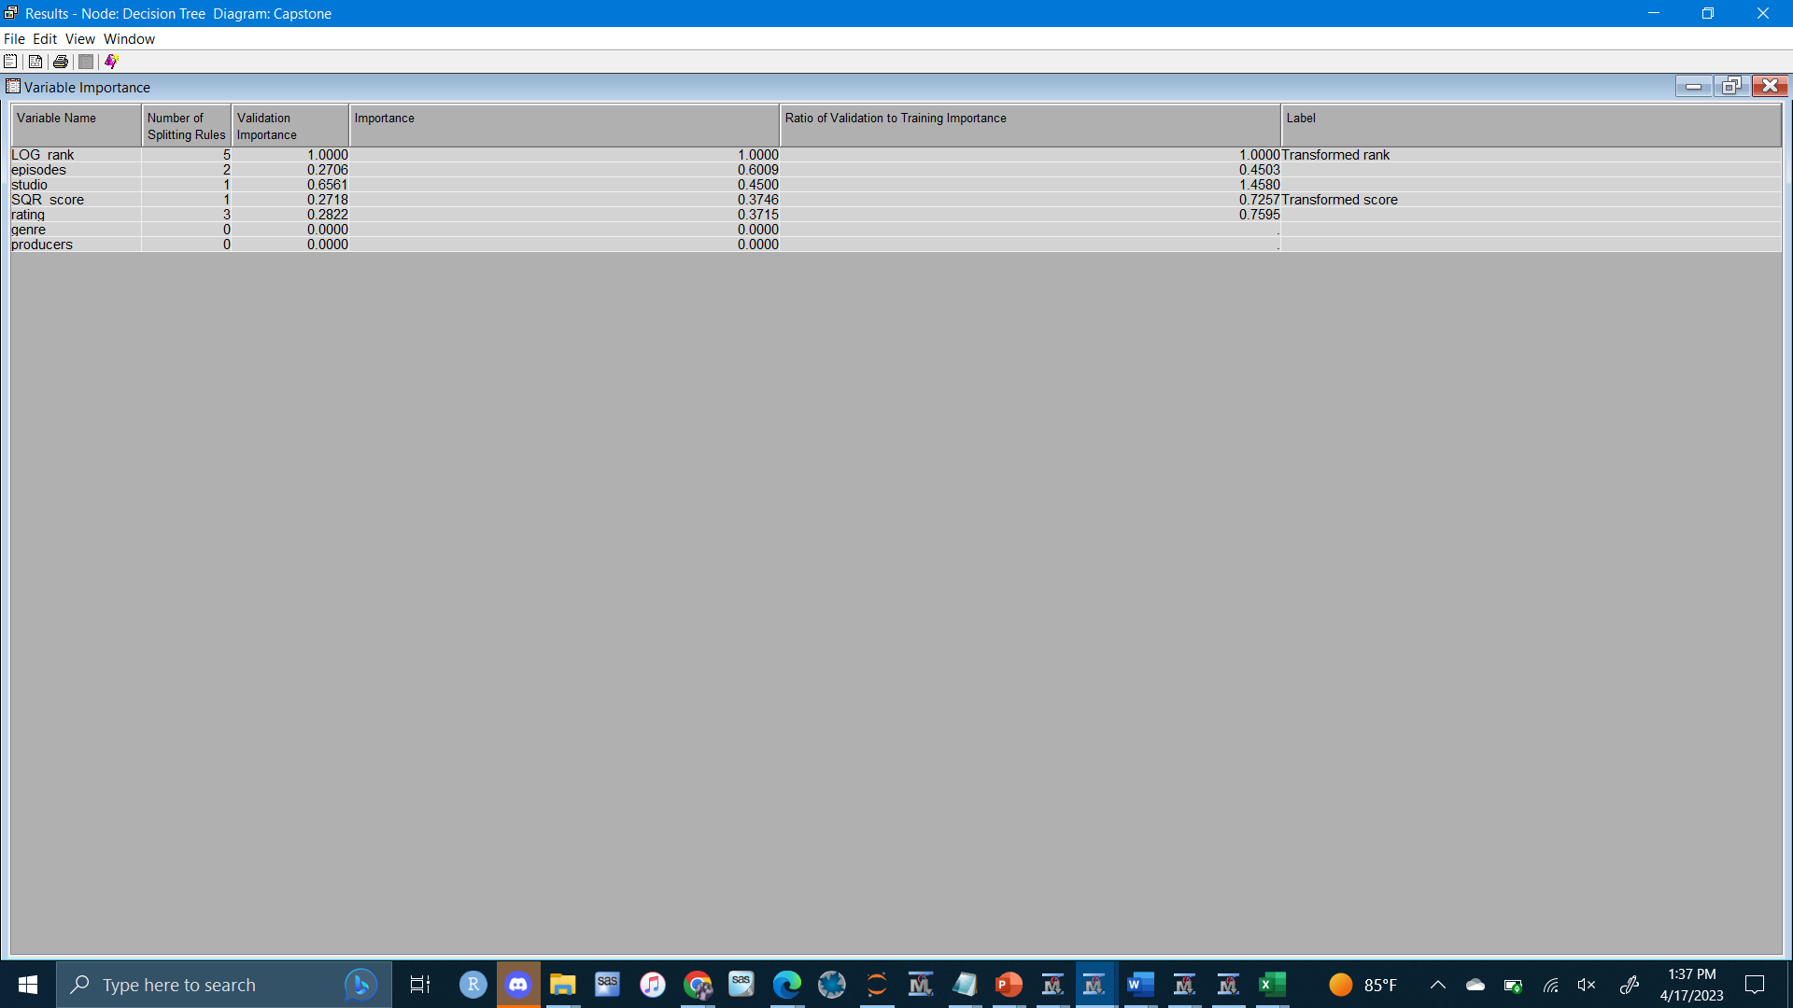
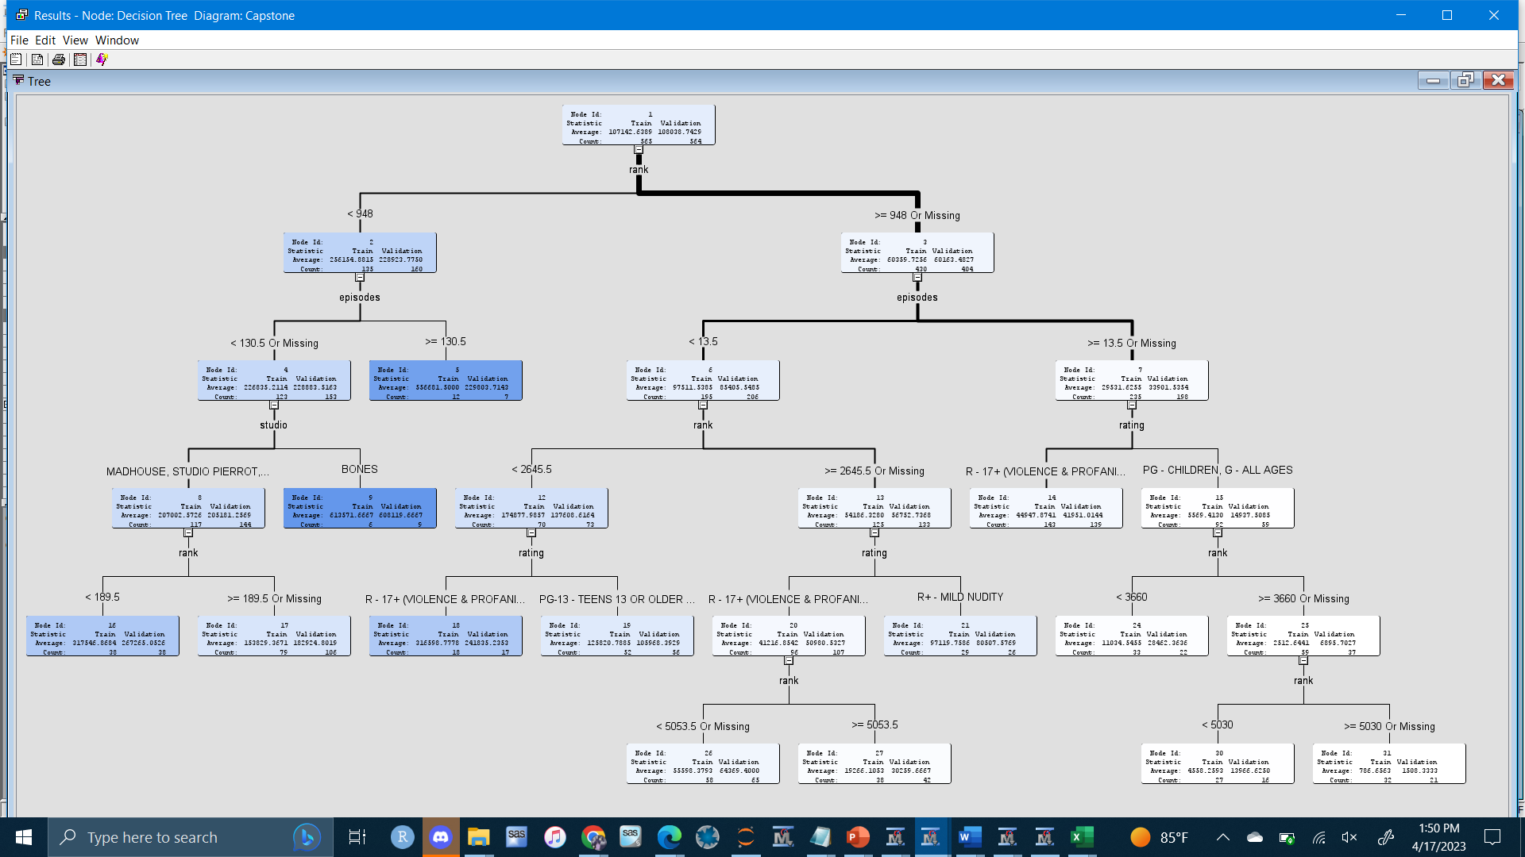
Supervised Model: Decision Tree
Validation ASE = 2.075E10

Slide 12
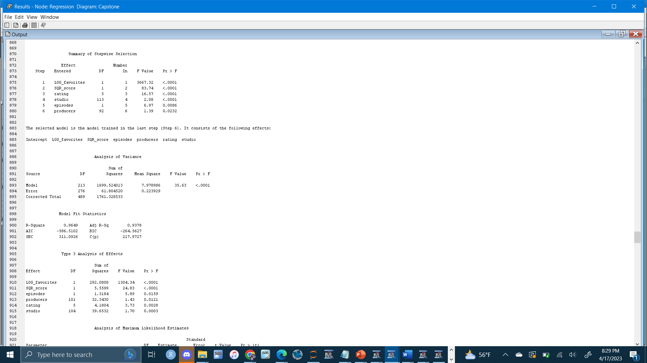
Supervised Model: Linear Regression
Selection Model: Stepwise
Adjusted R Squared – 93.78%

Slide 13
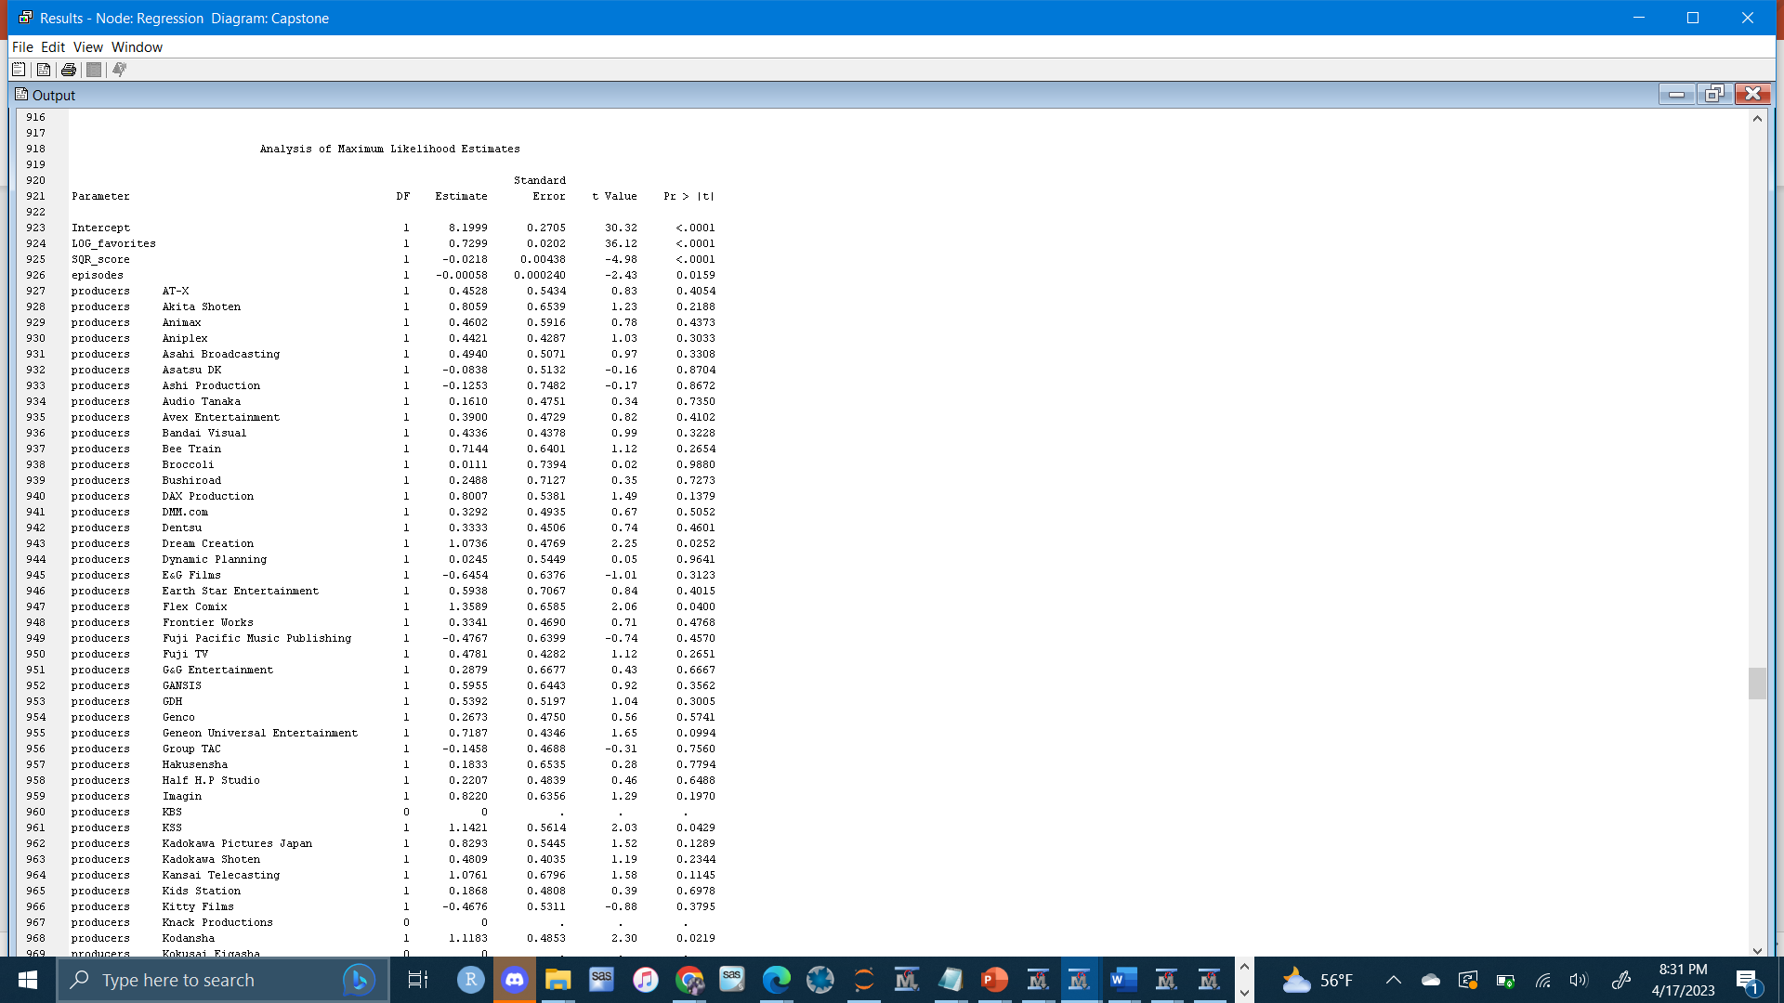
Supervised Model: Linear Regression
15 out of 110 Producers had negative effect on popularity
Number of episodes has a negative effect

Slide 14
Observations
15 out of 110 producers and number of episodes had a negative effect on popularity
IMDB Score is strongly correlated with popularity
Generally, shows with more episodes are less popular however more episodes will boost the popularity of high ranked shows.
Genre: Action, Harem, Josei, Military, and Mystery have a positive impact on popularity
Rating: R-17+(violence & profanity), PG and G have a positive impact while PG-13 has a negative impact

Slide 15
conclusion
Changes for Future Study:
Incorporate a way of controlling the effect of sequels
Sentiment Analysis on YouTube comments and Tweets
Find a different way of measuring popularity
Contributions:
Help distinguish anime from each other
Prove useful for anime production teams

